Slide 1
SMAA - StudEmo dataset
Methods for prediction of emotion - presentation
Group 2
Guściora Mateusz, Koptyra Bartłomiej, Kulas Michalina, Smolarczyk Sebastian

Slide 2


AGENDA
What is classification?
Dataset - StudEmo
Chosen methods:
Decision tree
Support Vector Machine (SVM)
Neural Network
Source:
https://thenounproject.com/icon/agenda-700063/
Source: https://machinelearningmastery.com/classification-accuracy-is-not-enough-more-performance-measures-you-can-use/

Slide 3
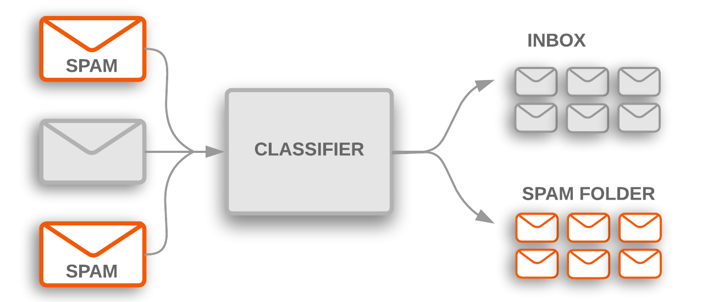
WHAT IS CLASSIFICATION?
Classification is a data science task of predicting the value of a categorical variable (target or class) by building a model based on one or more numerical and/or categorical variables (predictors or attributes).^{[1]} In statistics, classification is the problem of identifying which of a set of categories (sub-populations) an observation, (or observations) belongs to.^{[2]}
source:
https://developers.google.com/machine-learning/guides/text-classification/images/TextClassificationExample.png
[1] Classification definition, Dr. Saed Sayad, 2021, source: saedsayad.com/classification.htm [2] Statistical classification, source: en.wikipedia.org/wiki/Statistical_classification
Notes:
Sebastian: Ok, so what is classification? There is a definition on the slide, but to put in into more practical words. We could say classification is the process of predicting the class of given data points. Classes are sometimes called as targets, labels or categories. For example, spam detection in email service providers can be identified as a classification problem. This is s binary classification since there are only 2 classes as spam and not spam. A classifier utilizes some training data to understand how given input variables relate to the class. In this case, known spam and non-spam emails have to be used as the training data. When the classifier is trained accurately, it can be used to detect an unknown email. Classification belongs to the category of supervised learning where the targets also provided with the input data. There are many applications in classification in many domains such as in credit approval, medical diagnosis, target marketing etcetera

Slide 4
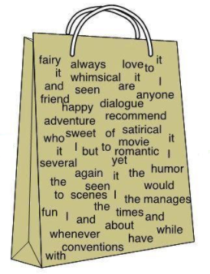
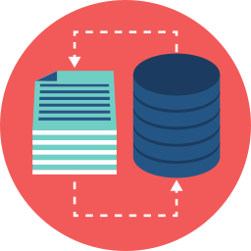

DATASET
source: https://styles.redditmedia.com/t5_2r97t/styles/communityIcon_ri05w19k4zh01.png
source: https://miro.medium.com/max/661/1*3K9GIOVLNu0cRvQap_KaRg.png
Notes:
Sebastian: Dataset on which we will be working consists of data which will allow us to work on recognition of emotions in texts. Input available in this dataset is text of a comment. We will be representing this input as continuous bag of words. Continuous bag of words model architecture tries to predict the target word by trying to understand the context of the surrounding words. The words in the dataset are converted to a vector representation. Output of this data set represents emotions, not only positive or negative affectivity, but also a measurement of how calming or how exciting the information is.

Slide 5
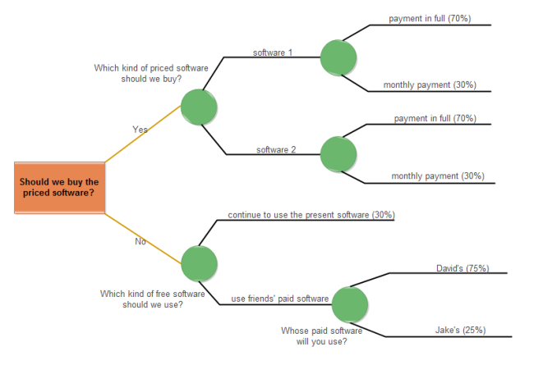

DECISION TREE - CLASSIFICATION
Source: https://www.edrawmax.com/decision-tree/
Source: https://code.4noobz.net/decision-tree-simple-example/

Slide 6
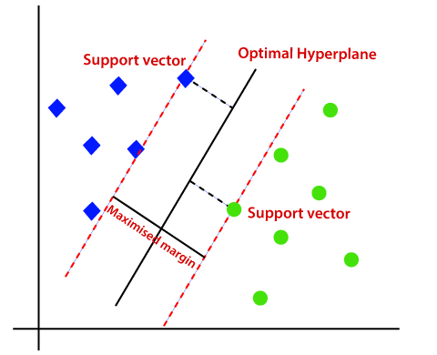
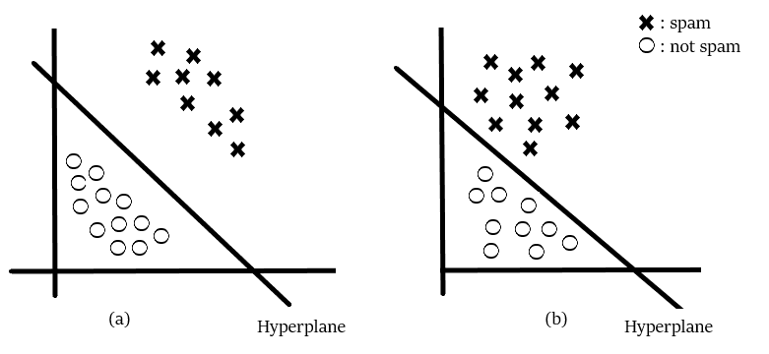
SUPPORT VECTOR MACHINE - SVM
Source: https://towardsdatascience.com/support-vector-machines-svm-c9ef22815589
Source: https://www.javatpoint.com/machine-learning-support-vector-machine-algorithm
Notes:
Support Vector machine is a supervised machine learning algorithm. In simplest terms SVM finds a hyperplane that creates boundary between types of data. In the picture you can see two different hyperplanes that separate data. I think most people would be more confident in the prediction from the model a. It is because the decision boundary has a greater distance to the closest data points. SVM is used to find the optimal hyperplane which means the a hyperplane that maximizes the distance between closest data points from different classes to the hyperplane. This points closest to the hyperplane are called support vectors. Only change in supports vectors changes the hyperplane. This means that SVM uses only subset of training points (support vectors) so it’s memory efficient. This means that inherently SVM performs only binary classification (which means choosing between two classes). It also implies that SVM is designed for data that is linearly separable.
SVM assumes that you have inputs are numerical instead of categorical. So you can convert them using one of the most commonly used “one hot encoding , label-encoding etc”.
Since SVM is able to classify only binary data so you would need to convert the multi-dimensional dataset into binary form using (one vs the rest method / one vs one method) conversion method.

Slide 7
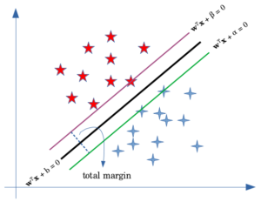
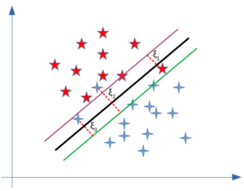
HARD MARGIN AND SOFT MARGIN - SVM
Source: https://www.baeldung.com/cs/svm-hard-margin-vs-soft-margin
Source: https://www.baeldung.com/cs/svm-hard-margin-vs-soft-margin
Notes:
Hard margin SVM is used for linearly separable data. Nonetheless used dataset can contain noise which can make our dataset non-linearly separable. This problem can be solved using what’s called soft margin SVM. Such approach can also reduce overfitting or being to sensitive to outliers in cases of very small margins. In hard margin SVM we maximize the distance between two parallel hyperplanes lying on support vector. In case of soft magrin we should minimize misclassification error. The loss of a misclassified point is called a slack variable and is added to the previous problem of hard margin SVM. This introduces new regularization parameter C which controls how much misclassification should be allowed.

Slide 8
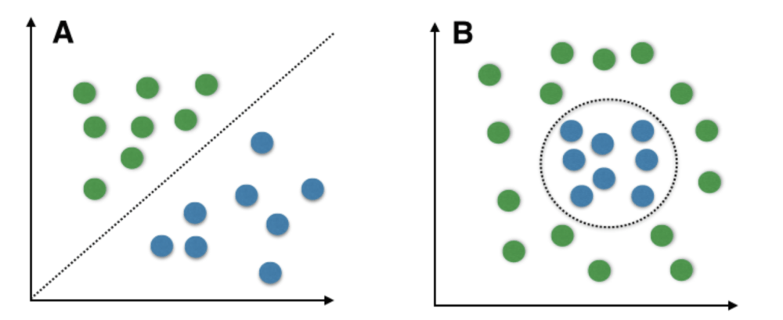
NON-LINEAR SVM - KERNEL TRICKS
Source: https://www.geeksforgeeks.org/introduction-to-support-vector-machines-svm/
Notes:
SVM can also be used for data that is separable but not linearly separable. The idea is to separate data points by projecting them into a higher dimension by adding relevant features. Kernel tricks are a way to lower computational complexity by substituting computations in higher dimension. Given two data points a Kernel function tells you what is the similarity between them in the newly transformed feature space. This similarity function is mathematically a kind of a complex dot product.
Pros of Kernelized SVM:
They perform very well on a range of datasets.
They are versatile : different kernel functions can be specified, or custom kernels can also be defined for specific datatypes.
They work well for both high and low dimensional data.
Cons of Kernelized SVM:
Efficiency (running time and memory usage) decreases as size of training set increases.
Needs careful normalization of input data and parameter tuning.
Does not provide direct probability estimator.
Difficult to interpret why a prediction was made.

Slide 9
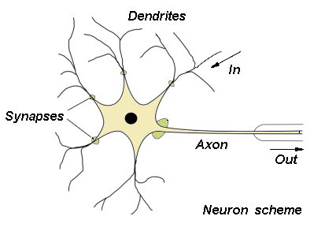
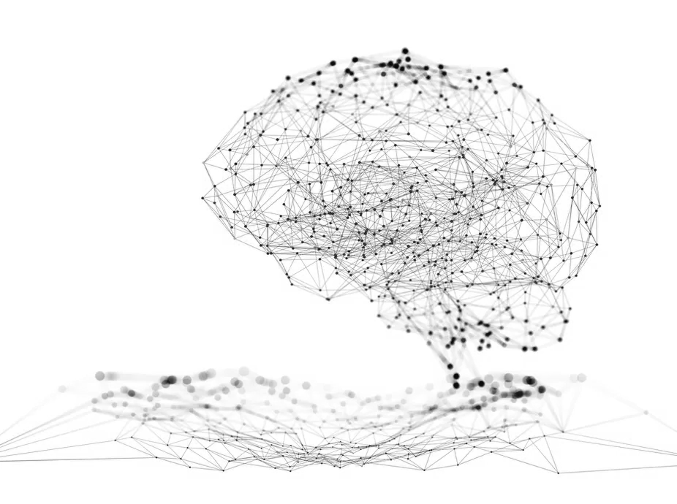
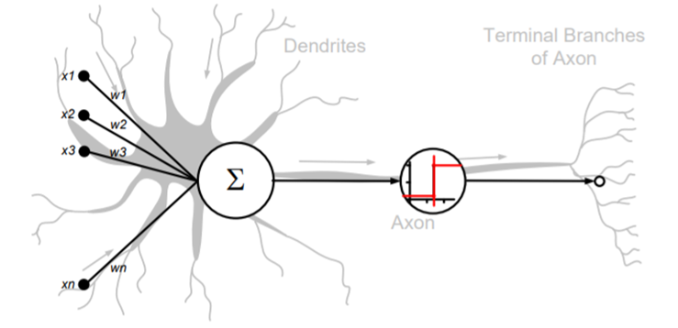
NEURAL NETWORK - BASICS
Artificial Neural network - imitation of biological one
Dendrites, Synapses, Axon
Many Inputs, Weights, Sum junction, Activation function, Output
https://home.agh.edu.pl/~vlsi/AI/intro/
http://zsi.ii.us.edu.pl/~nowak/si/SI_w4.pdf
Source: https://theconversation.com/what-is-a-neural-network-a-computer-scientist-explains-151897

Slide 10
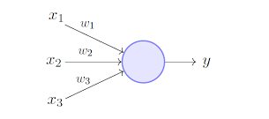
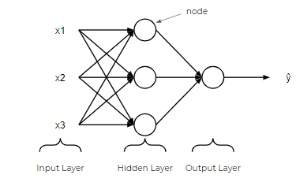
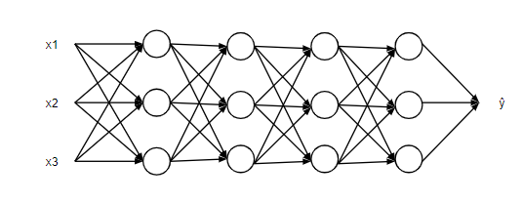
NEURAL NETWORK - BASICS
Perceptron - simple model of neuron
Most NN have Input Layer, Hidden Layer/s, Output Layer
Many Inputs, Weights, Sum junction, Activation function, Output
Perceptron - single layer
https://towardsdatascience.com/what-is-a-perceptron-210a50190c3b
https://towardsdatascience.com/a-beginner-friendly-explanation-of-how-neural-networks-work-55064db60df4
https://towardsdatascience.com/a-beginner-friendly-explanation-of-how-neural-networks-work-55064db60df4

Slide 11
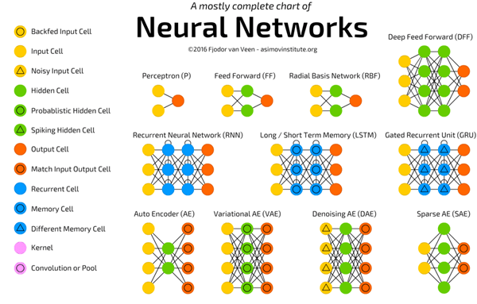
NEURAL NETWORK
Paradigm (Supervised, unsupervised)
Learning rule
Architecture (Single/Multi Layer,
FeedForward/Competitive, ANN, RNN, CNN...)
Learning Algorithm
https://towardsdatascience.com/the-mostly-complete-chart-of-neural-networks-explained-3fb6f2367464
Advantages: computational power, non-linear modeling capabilities, multiple applications – e.g. text classification/prediction

Slide 12
Thank you for your attention!
Any questions?

